Slide 1

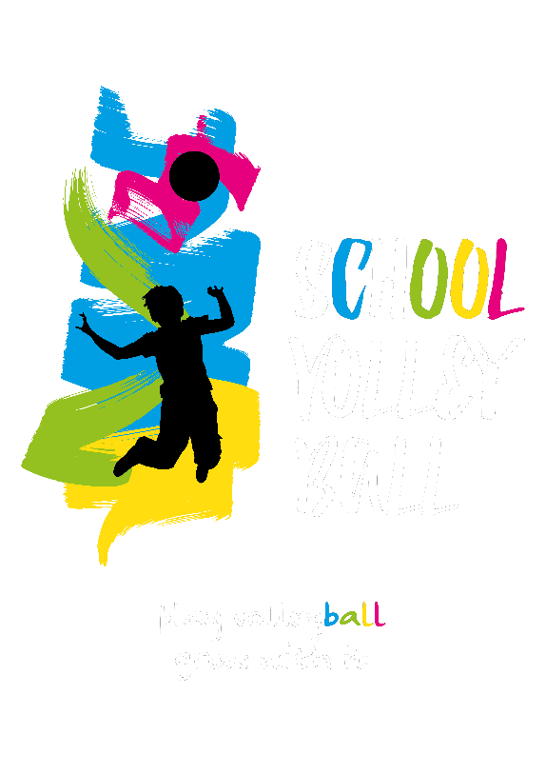
Viana do Castelo, Portugal
12 -14 June 2026

Slide 2
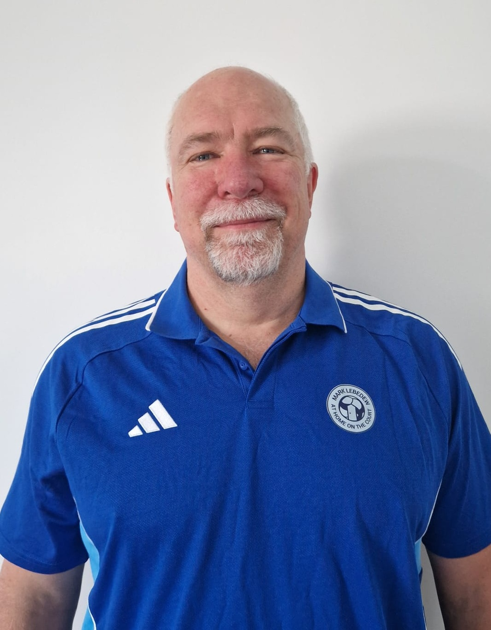
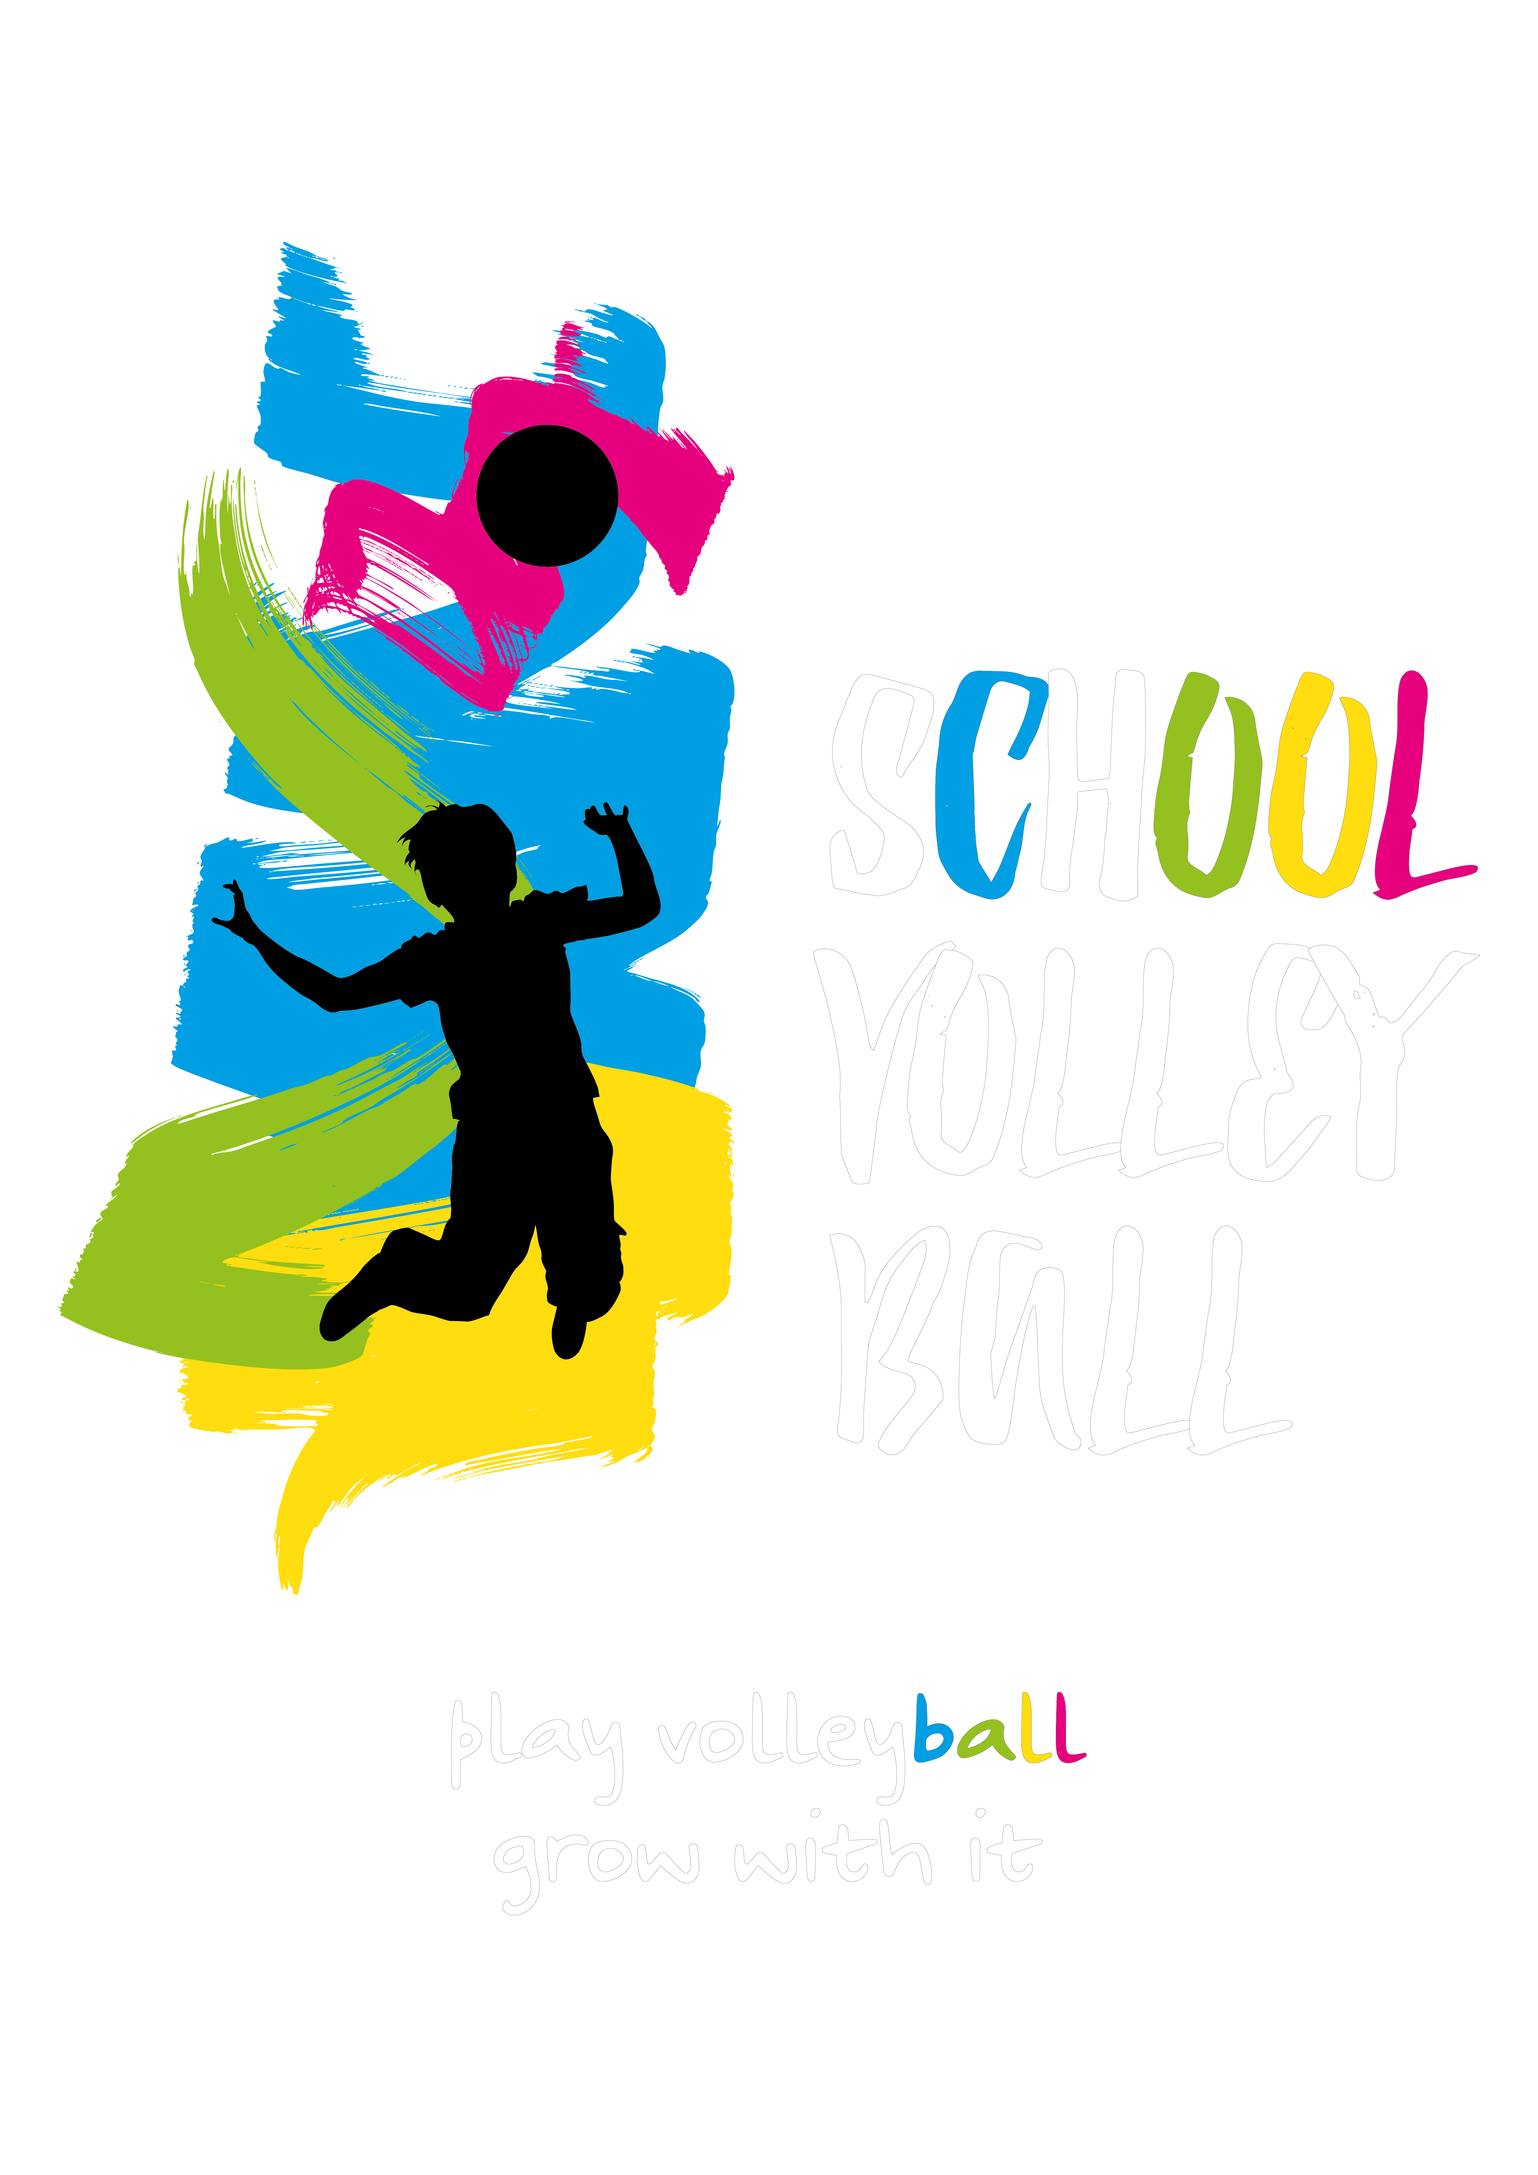
DEVELOPING AN INDIVIDUAL TRAINING METHODOLOGY
Mark
LEBEDEW
Head Coach – Stal Nysa, Poland

Slide 3
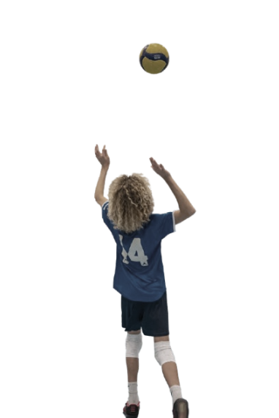

INTRODUCTION

Slide 4

INTRODUCTION
The instruction I was given was to give insight into how the professional level works. So that will be my focus.
I am a practitioner. I studied sport at university. I have studied widely. I have coached more or less every day for the last 30 years. I have tried many things. To quote Michael Jordan, I have failed over and over again. Everything I do is based on sound theory and research, but I don’t always remember exactly which bit comes from where.
Take everything I say with a grain of salt.
Current models of development include Constraints Led Approach, Ecological Systems. I don’t think these are fundamental improvements to Teaching Games for Understanding.
Today’s task is to start with sound training principles, creating a practical and flexible model for individual and team development
45%
64%

Slide 5
THEORY OF PRACTICE

Slide 6
PRINCIPLES OF TRAINING
Overload
  i.e. practice a lot of what you want to get better at, do a lot of repetitions
Recovery
  i.e. have some days when you practice less
Reversibility
  i.e. if you don’t practice something you get worse at it
Specificity
  i.e. practice exactly the thing you want to get better at
Individuality
  i.e. everybody learns and improves differently
45%
64%

Slide 7
UNDERSTANDING THE ROLE OF EACH PRINCIPLE
Some of these elements are mutually exclusive
  Overload (repetitions) and specificity are opposite
  Overload and recovery are opposite
  Recovery and reversibility are opposite
Balance is important
Timing is important
  In the session
  In the program
45%
64%

Slide 8
THE GOAL DEFINES THE METHOD
Defining our goal precisely is important because it informs everything we do from that point on
What is our overall goal?
To get better at playing volleyball
This is the key and we must never forget this
45%
64%

Slide 9
VOLLEYBALL
Volleyball is the interaction of techniques, players, space
Volleyball is NOT a collection of techniques
It is infinitely complex
45%
64%

Slide 10
SUMMARY

Slide 11
SUMMARY
We want to improve at playing volleyball
We need to follow sound principles
The only way to get better at playing volleyball, is to play volleyball, i.e. closely follow the principle of specificity. That must be our starting point.
We must understand all training principles and how they interact with each other to optimise development
45%
64%

Slide 12
TIPS AND TRAPS

Slide 13
TIPS AND TRAPS
We cannot prepare for the complexity of the game without also training in a complex environment
‘Illusion of Control’ trap
Reducing complexity makes us feel better, gives us a feeling of control, but does not prepare us for playing volleyball
45%
64%

Slide 14
THANK YOU
Q & A

